Slide 1
e-leisure activities
Teaching resources
“Funded by the European Union. Views and opinions expressed are however those of the author(s) only and do not necessarily reflect those of the European Union or the European Education and Culture Executive Agency (EACEA). Neither the European Union nor EACEA can be held responsible for them.”
Project No: 2021-1-IT02-KA220-ADU-000035139

Slide 2
1. Introductory activity
2021-1-IT02-KA220-ADU-000035139
1.1. Discussion
Have you ever received a suspicious email? (e.g claiming you have won a major prize or are at risk of losing access to your account)
Share a similar experience with the people next to you
What are you afraid of when you surf the Internet?
How do you deal with suspicious emails?
What security measures do you take when you surf the Internet?
What security measures do you take when you check your email?
1

Slide 3
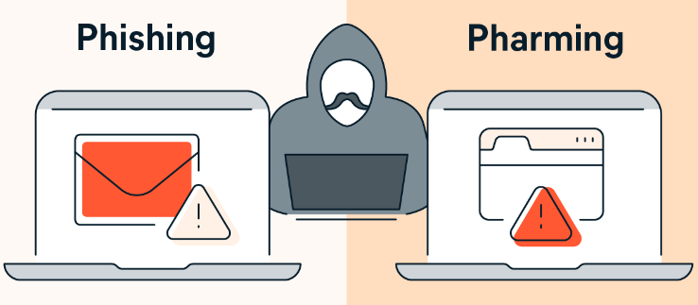
2. Comparative exercise
2021-1-IT02-KA220-ADU-000035139
2
Source: https://www.avast.com/es-es/c-pharming

Slide 4
2. Comparative exercise
2021-1-IT02-KA220-ADU-000035139
Phishing | Mainly carried out through the use of fake emails. This is an attempt to trick people into visiting malicious websites by sending emails or other messages which pretend to come from banks or online shops.
Pharming | An online scam that involves directing people to fraudulent websites that mimic authentic websites. Information appears legitimate so users are tricked into sharing sensitive information.
3

Slide 5
2. Comparative exercise
2021-1-IT02-KA220-ADU-000035139
How does Airbnb work?
Although you can search for accommodation immediately on the website, you should remember that Airbnb is a website for renting accommodation between private individuals. Therefore, registration, verification of ID and a profile are required to make bookings.
When you register, the website asks you to create a personal profile so that potential hosts have the opportunity to find out about you and write reviews after you leave (and the other way around).
4

Slide 6
2. Comparative exercise
2021-1-IT02-KA220-ADU-000035139
With Airbnb you can send the hosts a message if you have any questions about the accommodation. With some hosts you can book immediately, while with others you first have to submit a request for approval.
Airbnb has a cyber security department that ensures the safety of all parties involved in the transactions. Therefore, communication with hosts and payments are always made through the Airbnb website (confirmation messages are sent by email).
Help secure your account - Airbnb Help Centre. (s. f.). Airbnb. https://www.airbnb.co.uk/help/article/501
5

Slide 7
3. Case study
2021-1-IT02-KA220-ADU-000035139
3.1.A Step by step:
1. J.O. goes to the official AirBnB website to search for a house in Menorca.
2. He searches and finds a suitable accommodation and starts a conversation with the host, whose name is Emilio.
3. J.O. follows the instructions on the official website. He receives several emails from the official Airbnb account confirming his interest in the house and its availability. At this point he has not paid anything yet.
Nadal, P. (2017b, june 20). El timo de las falsas (pero casi idénticas) webs de Airbnb. El Paí­s. Retrieved from: https://elpais.com/elpais/2017/06/20/paco_nadal/1497912545_734848.html
6

Slide 8
3. Case study
2021-1-IT02-KA220-ADU-000035139
4. Emilio tells J.O. that he is having problems with the platform and asks for J.O.'s private email account to provide him with information about the house, its location, etc.
5. J.O. receives an email from Airbnb with a form for the payment and proceeds to pay for the accommodation.
6. As soon as the transfer has been made, J.O. receives a confirmation of payment and all information about the accommodation.
Nadal, P. (2017b, june 20). El timo de las falsas (pero casi idénticas) webs de Airbnb. El Paí­s. Retrieved from: https://elpais.com/elpais/2017/06/20/paco_nadal/1497912545_734848.html
7

Slide 9
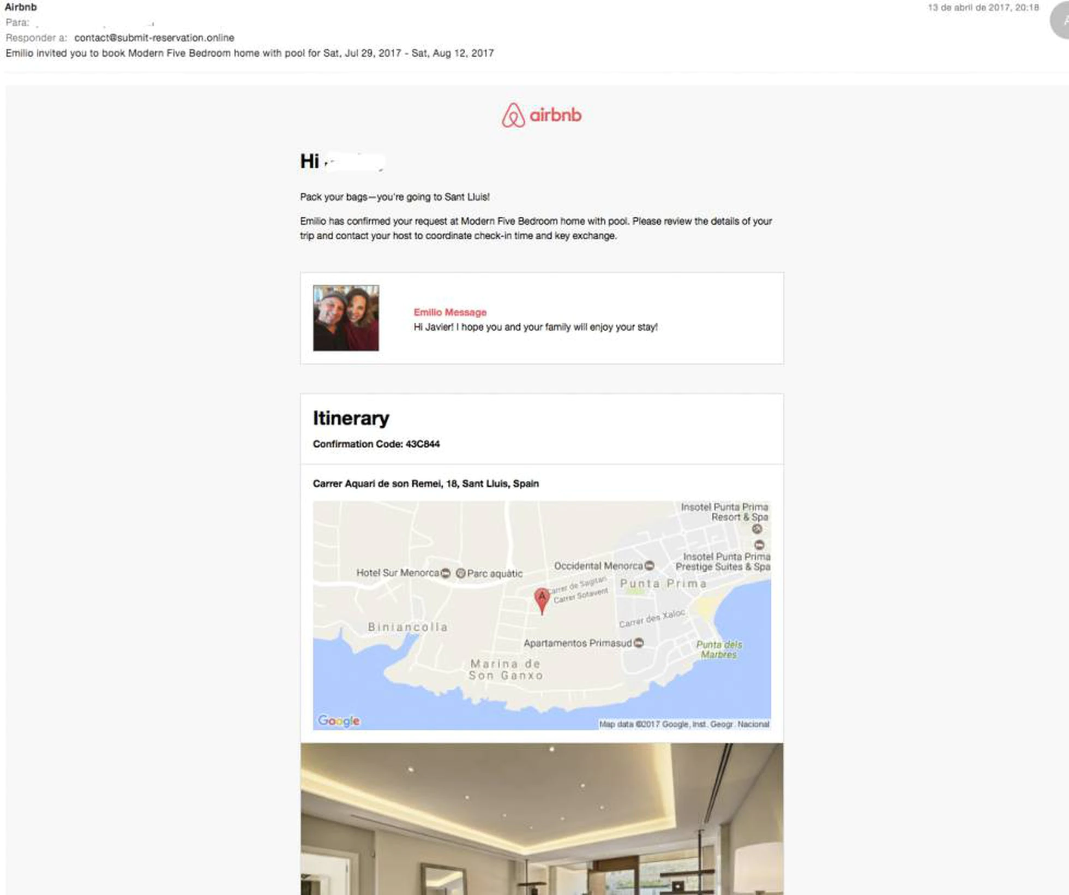
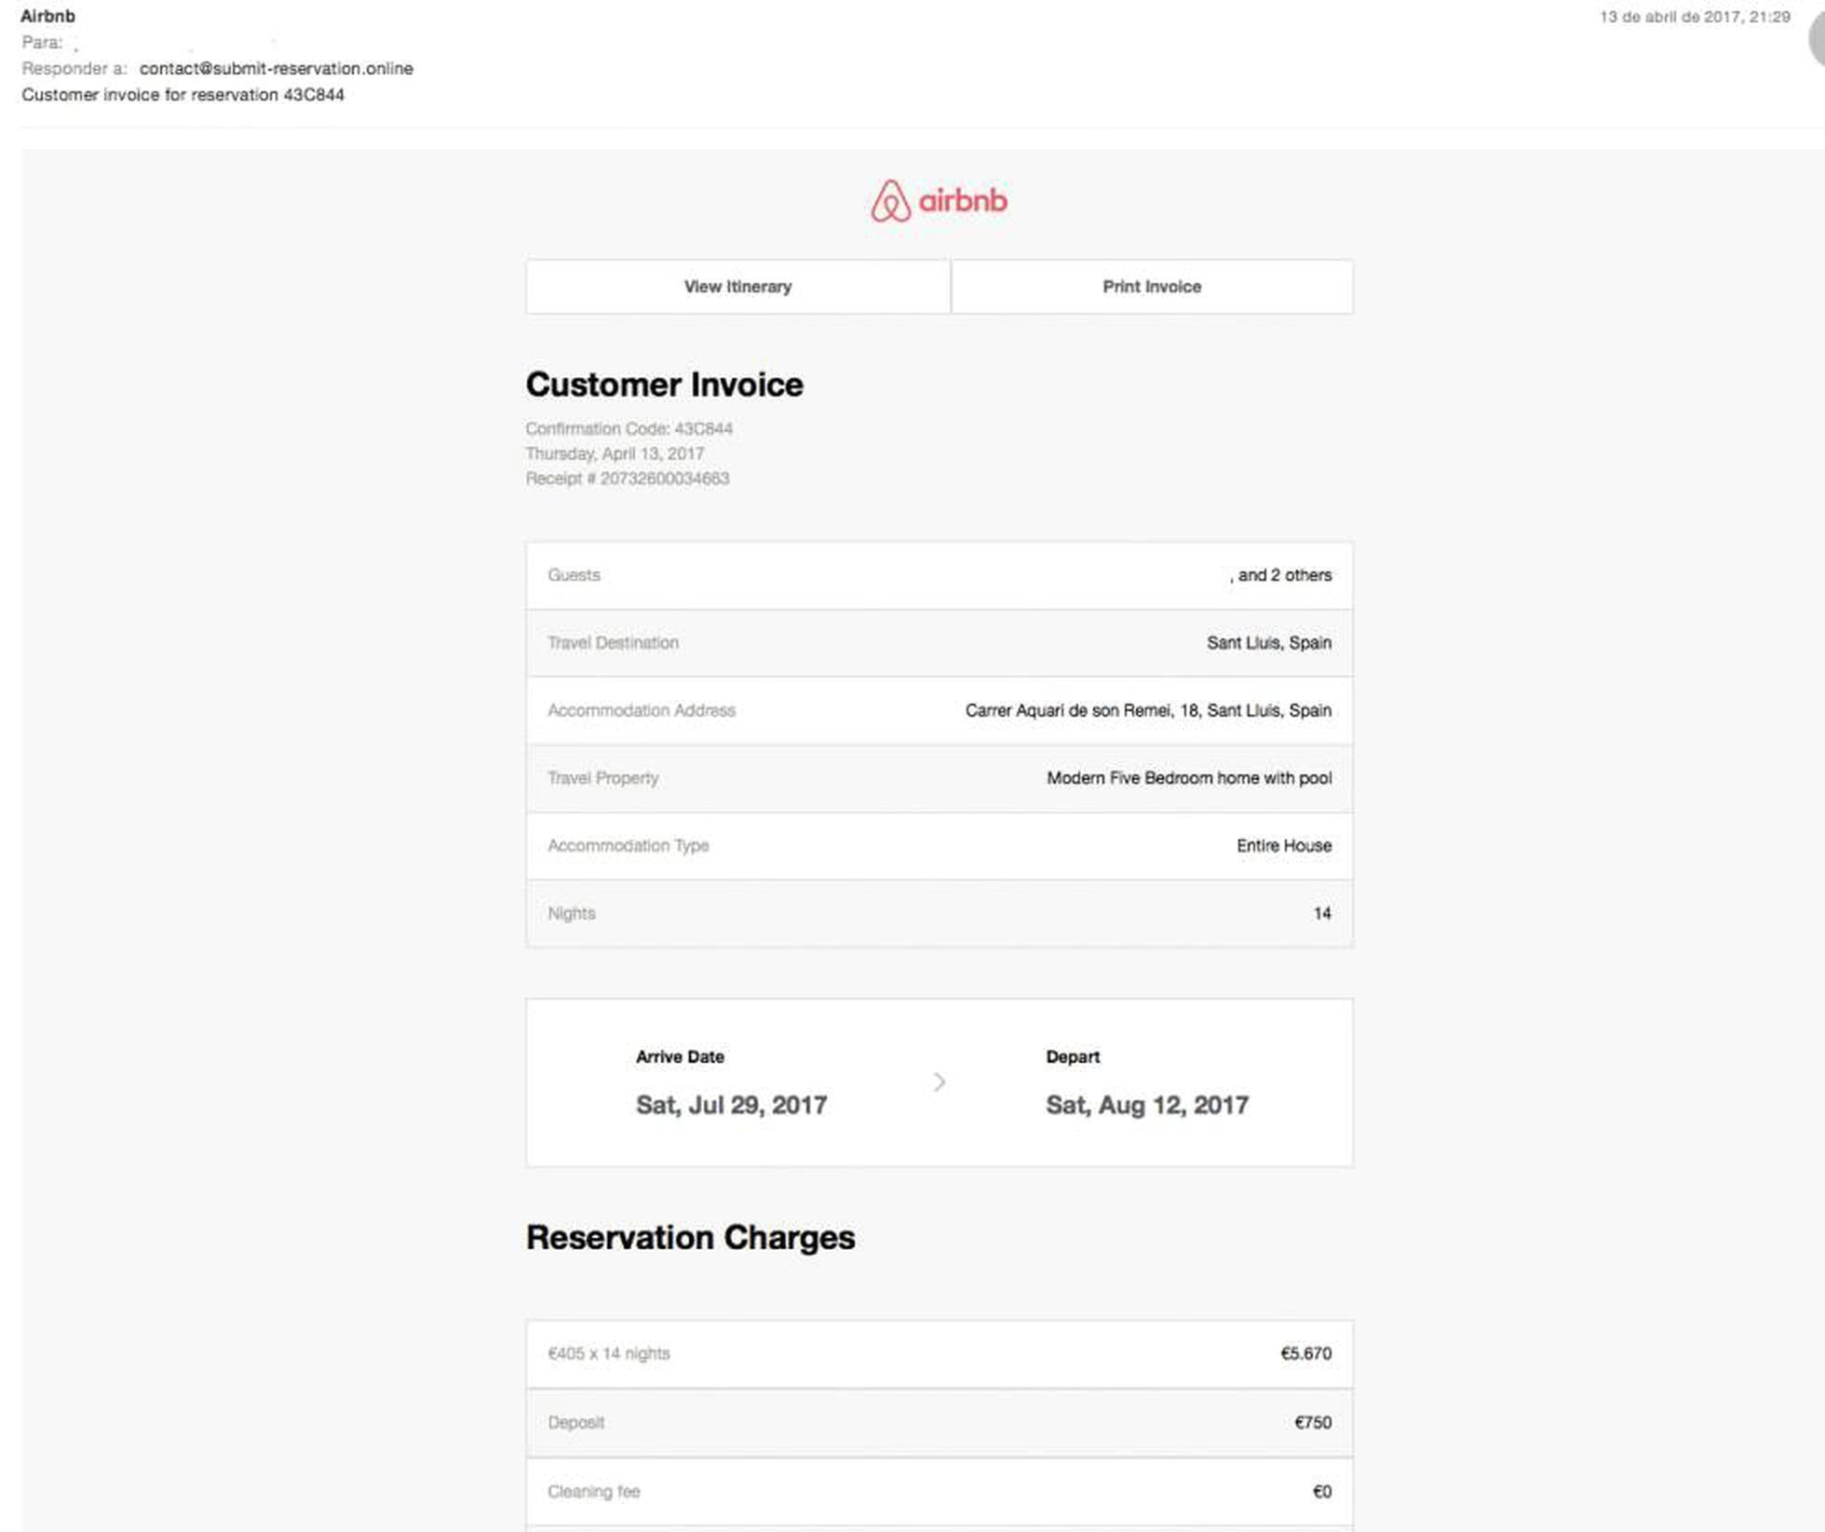
Nadal, P. (2017b, june 20). El timo de las falsas (pero casi idénticas) webs de Airbnb. El Paí­s. Retrieved from: https://elpais.com/elpais/2017/06/20/paco_nadal/1497912545_734848.html

Slide 10
3. Case study
2021-1-IT02-KA220-ADU-000035139
3.1.B Brainstorming
Did J.O. make a mistake?
At which step did he make the mistake?
What is this phishing or pharming?
8

Slide 11
3. Case study
2021-1-IT02-KA220-ADU-000035139
3.1.B Brainstorming
Step number 4 is where it all goes wrong. J.O. does not doubt Emilio's intentions and ends up giving him his personal details (private email address) and a direct contact to bypass the security of the Airbnb platform. From that moment on, the scammer (Emilio) assumed the identity of Airbnb and sent J.O. all the steps that would have been usual for a booking through the platform, with emails that looked exactly like the real ones.
9

Slide 12
3. Case study
2021-1-IT02-KA220-ADU-000035139
3.1.B Brainstorming
J.O. was swindled out of € 6,700 (real case in Spain 2017)
J.O. became suspicious when he realised that the address (accommodation) Emilio gave him did not exist. He wrote to Airbnb to confirm the address (Airbnb's official email address) and discovered that he had been scammed. When he complained to Airbnb, they confirmed that they could not intervene as the payment was made outside the platform.
10

Slide 13
3. Case study
2021-1-IT02-KA220-ADU-000035139
Remember: Never transfer money outside of Airbnb or share your email address before a booking has been accepted. If someone emails you asking you to pay or accept payment outside of Airbnb, you should contact Airbnb immediately.
Help secure your account - Airbnb Help Centre. (s. f.). Airbnb. https://www.airbnb.co.uk/help/article/501
11

Slide 14
3. Case study
2021-1-IT02-KA220-ADU-000035139
3.1.B Brainstorming
What safety precautions should J.O. have taken?
- ……………………….
- ……………………….
- ……………………….
- ……………………….
12

Slide 15
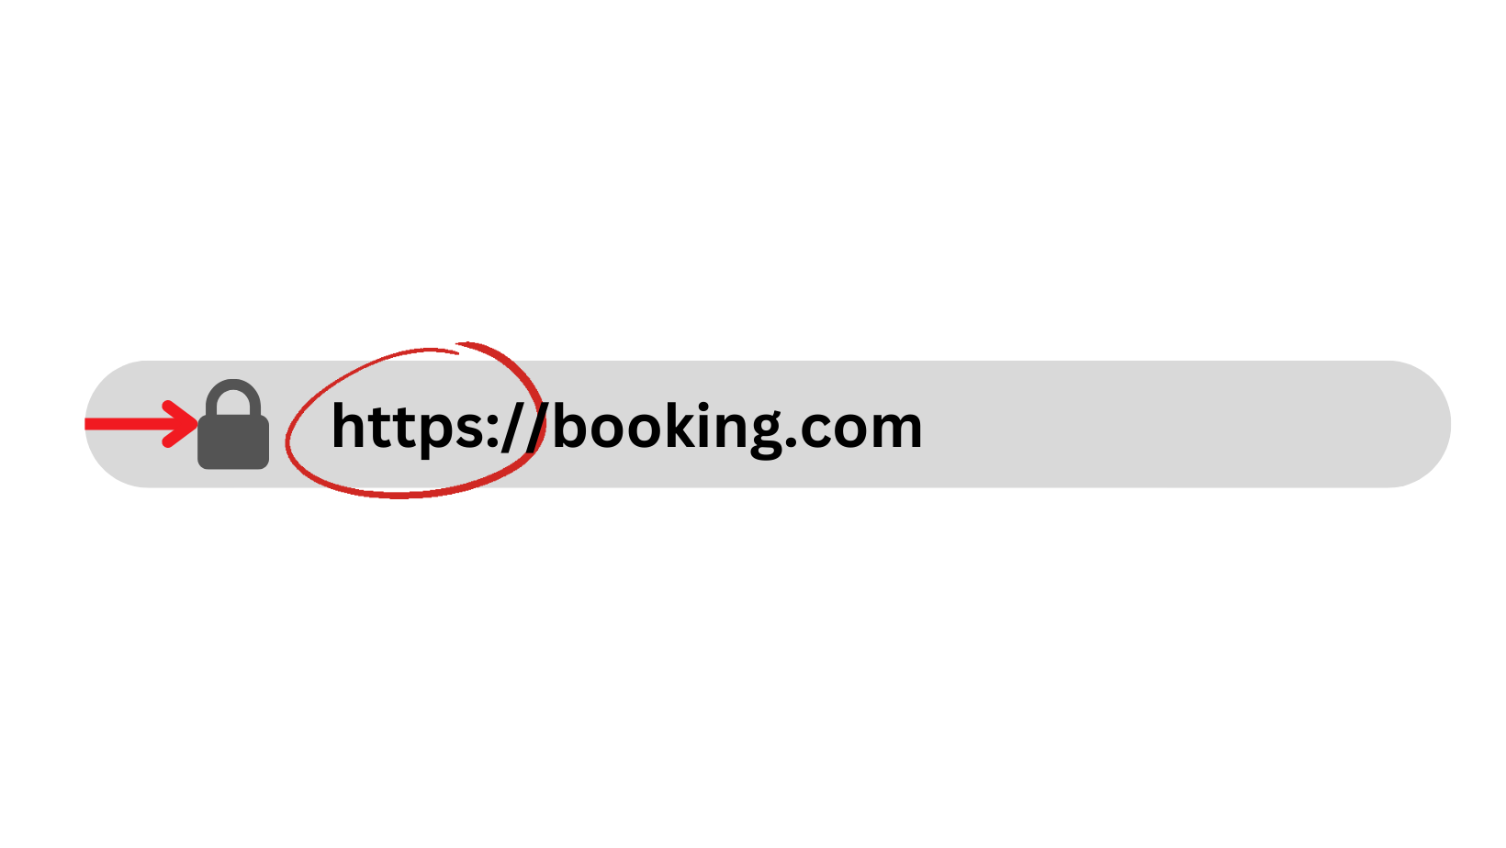
4. Spot the scam
2021-1-IT02-KA220-ADU-000035139
4.1. Secure URL
Look at the URL of the web page - does it start with http or https? When a URL starts with https://, it means that the connection is secure. Almost all major websites, especially those that handle personal information, protect their data with an https connection. If a URL only includes http, the connection is not secure and the page may not be secure.
If you see an address like “airbnb1.com” or “airbnb-bookings.com,” don’t enter your information.
13

Slide 16
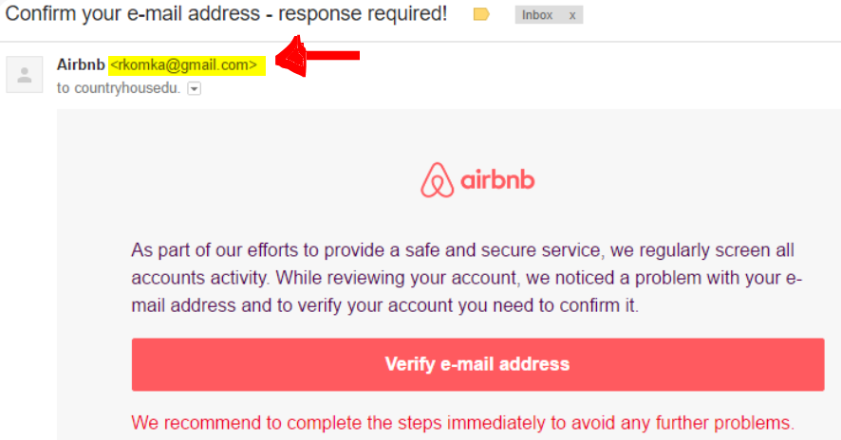
4. Spot the scam
2021-1-IT02-KA220-ADU-000035139
4.1. Payments outside the Airbnb platform
If you receive a message from a host asking you to pay through another (non-Airbnb) app, bank transfer, or another website, it’s a scam.
Look for the signs of a phishing email, including misspelled words, grammatical errors and threatening or urgent language. Do not click on links or submit personal information if you are unsure about an email.
Source: Aura (s.d.) Don’t Let These 10 Airbnb Scams Ruin Your Vacation in 2023. Retrieved from: https://www.aura.com/learn/airbnb-scams
14

Slide 17
4. Spot the scam
2021-1-IT02-KA220-ADU-000035139
4.1. Payments outside an official platform
This can also be applied to other online hotel booking websites such as BOOKING.COM or HOTELS.COM or a hotel's official website.
In addition to the URL address, there are other important elements to look for on a website to make sure it is not a fake twin:
contact details (for example, make sure the e-mail address has its own domain, e.g. info@hotelname.com and not info@gmail.com).
Source: Aura (s.d.) Don’t Let These 10 Airbnb Scams Ruin Your Vacation in 2023. Retrieved from: https://www.aura.com/learn/airbnb-scams
15

Slide 18
4. Spot the scam
2021-1-IT02-KA220-ADU-000035139
4.1. Too good to be true
A price that is "too good to be true" is a big warning sign that you should not ignore. It could mean that the accommodation does not match the description or that the place does not exist at all.
Source: Aura (s.d.) Don’t Let These 10 Airbnb Scams Ruin Your Vacation in 2023. Retrieved from: https://www.aura.com/learn/airbnb-scams
16

Slide 19
4. Spot the scam
2021-1-IT02-KA220-ADU-000035139
4.1. 2FA (Two-Factor Authentication)
When you sign in to Airbnb from a new device you may be asked to confirm that it's really you. You might have to enter a security code sent to your phone or email, or verify some of your account details. You might also receive an account warning if someone tries to access your account.
Source: Aura (s.d.) Don’t Let These 10 Airbnb Scams Ruin Your Vacation in 2023. Retrieved from: https://www.aura.com/learn/airbnb-scams
Airbnb Help Centre. (s. d.-b). Help secure your account. Airbnb. Retrieved from: https://www.airbnb.co.uk/help/article/501
17

Slide 20
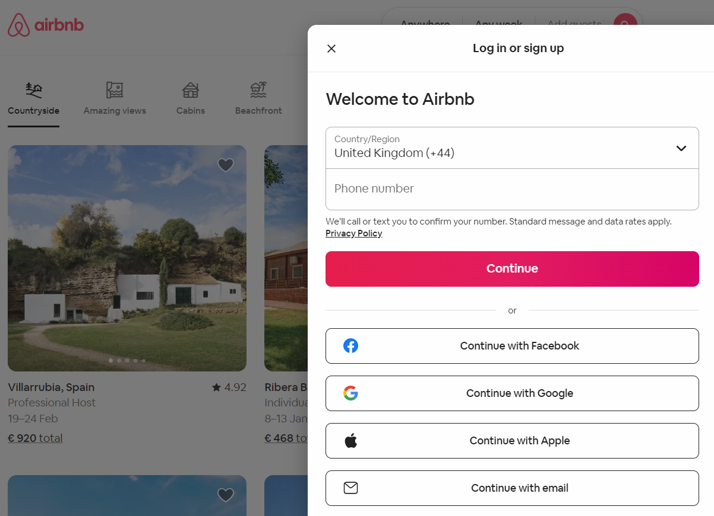
5. Exercise
2021-1-IT02-KA220-ADU-000035139
5.1 Create an Airbnb account
1. Go to airbnb.com
2. Click Sign Up or download the mobile app and follow the instructions.
You can sign up with any of the following:
Email address
Phone number
Facebook or Google account
18

Slide 21
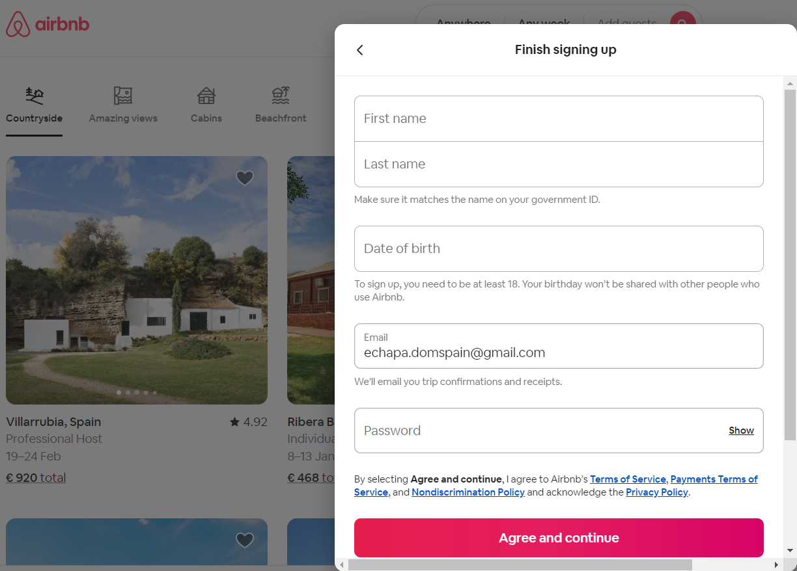
5. Exercise
2021-1-IT02-KA220-ADU-000035139
5.1 Create an Airbnb account
At a minimum, Airbnb needs your:
Full name
Email address
Confirmed phone number
(Follow steps)
19

Slide 22
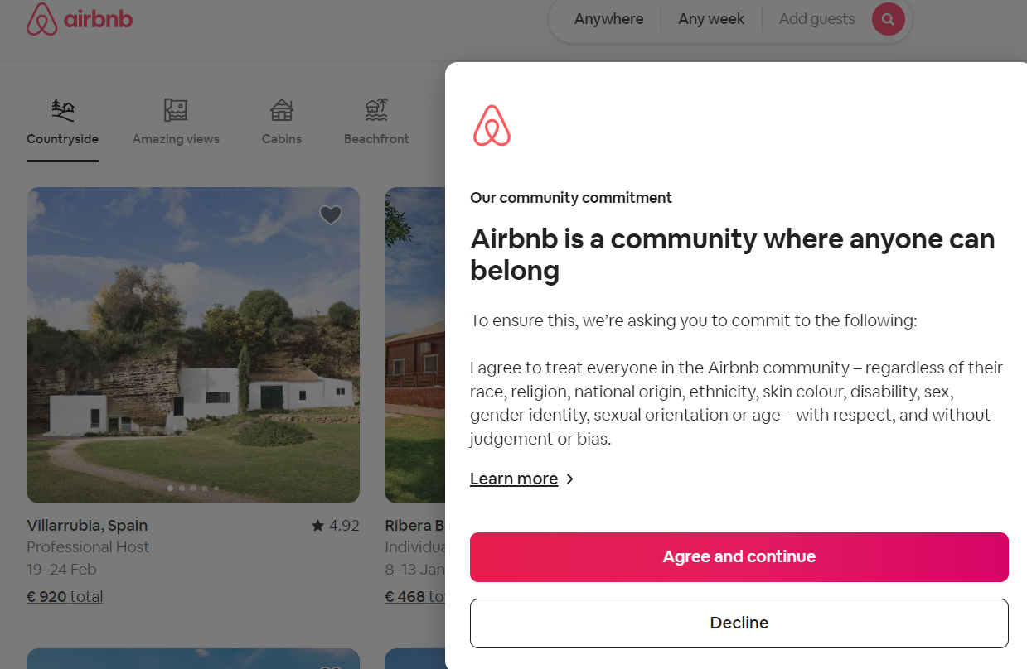
5. Exercise
2021-1-IT02-KA220-ADU-000035139
5.1 Create an Airbnb account
Agree to the code
of conduct and terms of use.
Airbnb Help Centre. (s. d.-b). Help secure your account. Airbnb. Retrieved from: https://www.airbnb.co.uk/help/article/501
20

Slide 23
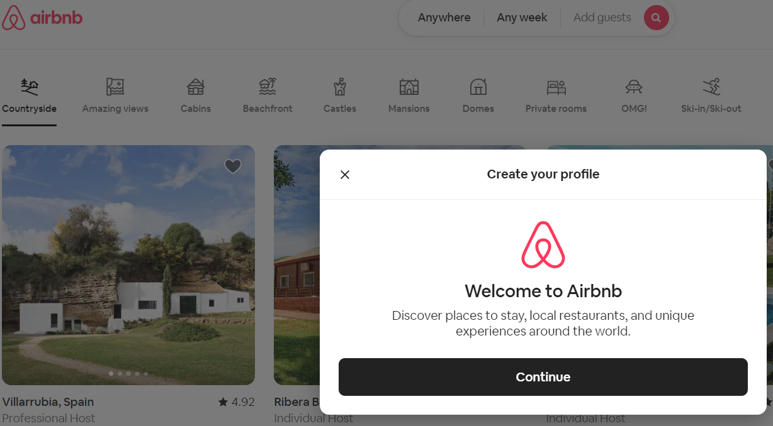
5. Exercise
2021-1-IT02-KA220-ADU-000035139
5.1 Create an Airbnb account
Follow the steps and
create your profile.
21

Slide 24
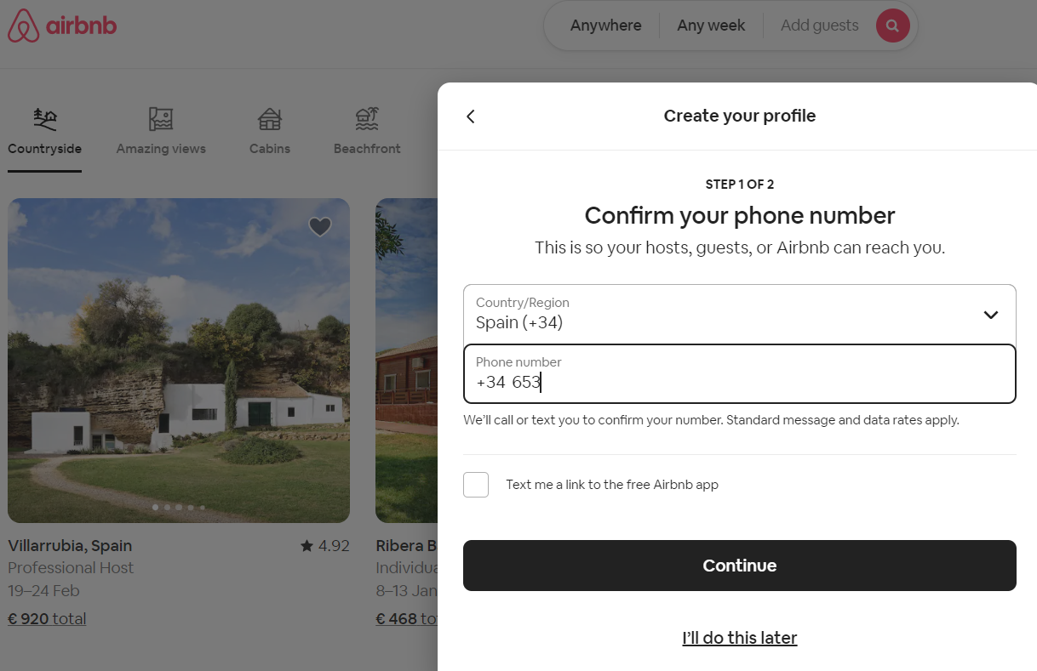
5. Exercise
2021-1-IT02-KA220-ADU-000035139
5.1 Create an Airbnb account
2FA: Confirm your phone number to receive a security message
Source: Aura (s.d.) Don’t Let These 10 Airbnb Scams Ruin Your Vacation in 2023. Retrieved from: https://www.aura.com/learn/airbnb-scams
Airbnb Help Centre. (s. d.-b). Help secure your account. Airbnb. Retrieved from: https://www.airbnb.co.uk/help/article/501
22

Slide 25
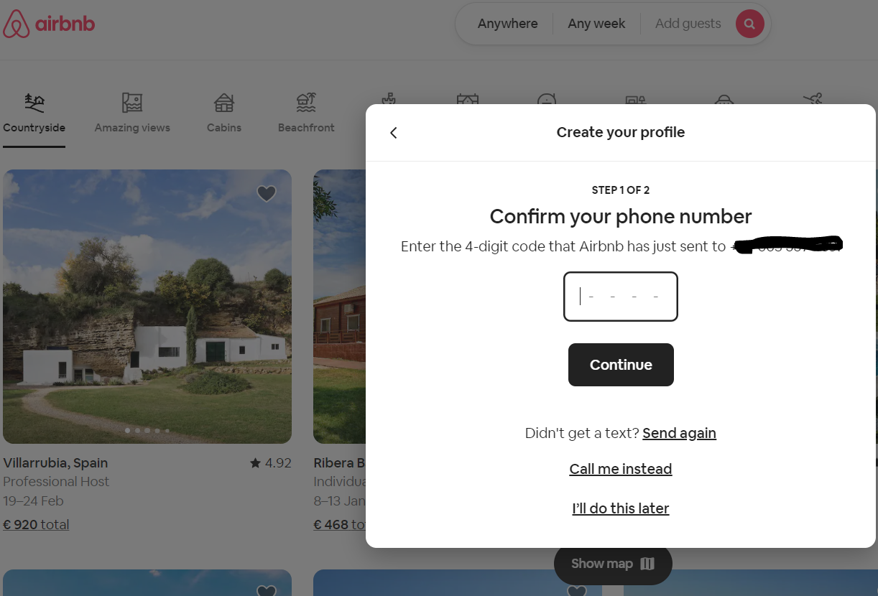
5. Exercise
2021-1-IT02-KA220-ADU-000035139
5.1 Create an Airbnb account
2FA: Enter the code sent to your phone and verify your identity
23

Slide 26
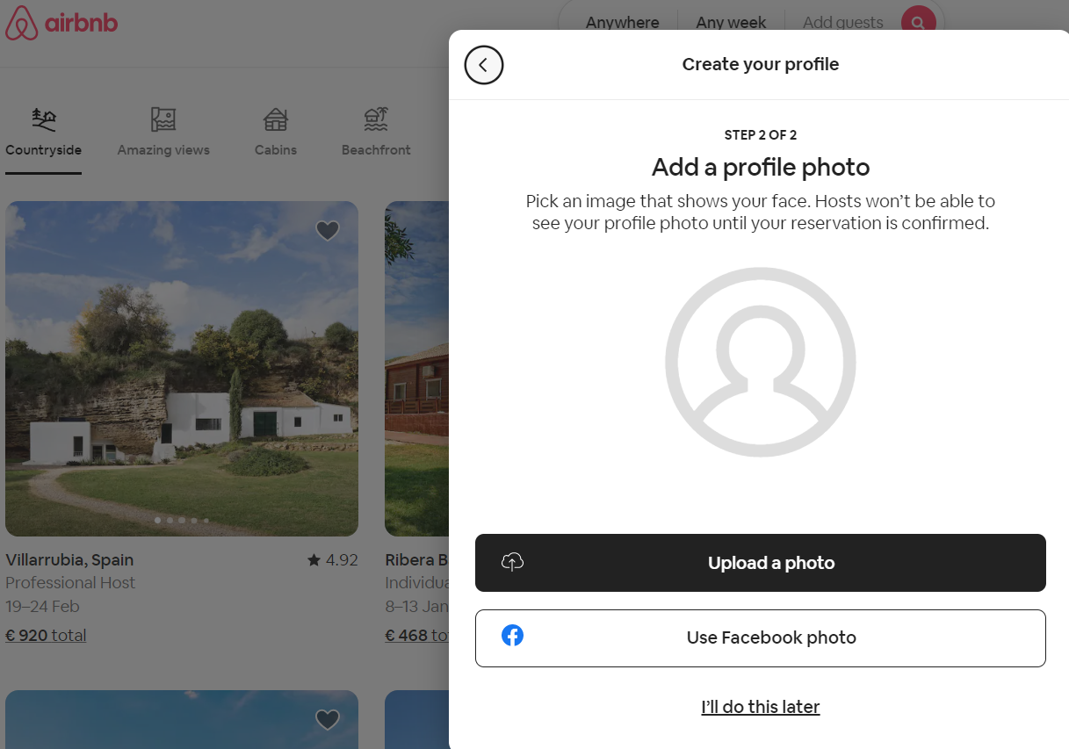
5. Exercise
2021-1-IT02-KA220-ADU-000035139
5.1 Create an Airbnb account
This step is not necessary at the moment, skip it by clicking on “I’ll do it later”
24

Slide 27
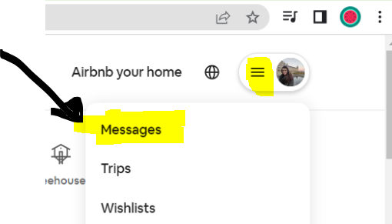
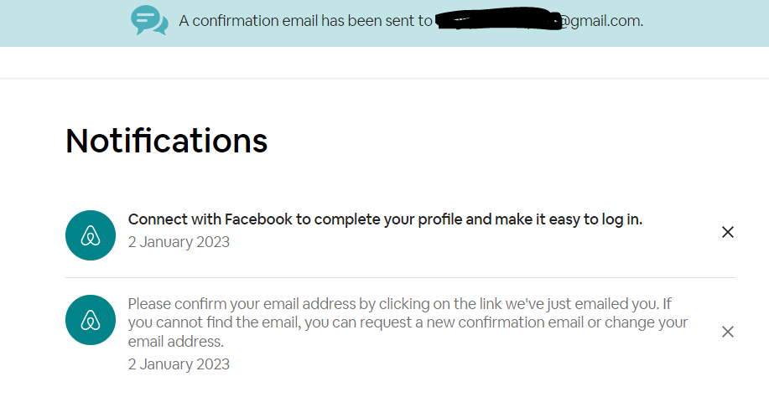
5. Exercise
2021-1-IT02-KA220-ADU-000035139
5.1 Create an Airbnb account
Go to the top right corner and click on the button (three horizontal lines). Then click on “Messages”. Then look for an airbnb email on your email mailbox.
25

Slide 28
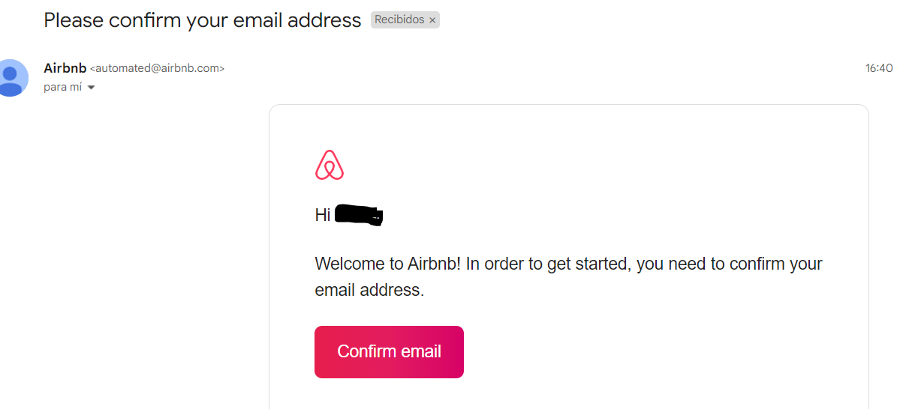
5. Exercise
2021-1-IT02-KA220-ADU-000035139
5.1 Create an Airbnb account
26

Slide 29
5. Exercise
2021-1-IT02-KA220-ADU-000035139
5.1 Create an Airbnb account
Check for official Airbnb domains. Legitimate emails from Airbnb will only come from the following domains:
If it's not sent from one of these addresses, it’s not from Airbnb.
@guest.airbnb.com @host.airbnb.com @noreply@qemailserver.com @outreach.airbnb.com @research.airbnb.com | @supportmessaging.airbnb.com @airbnb.zendesk.com @e.airbnb.com @express.medallia.com @ext.airbnb.com | @airbnb.com @airbnbaction.com @airbnblove.com @airbnbmail.com @support-email.airbnb.com
27

Slide 30
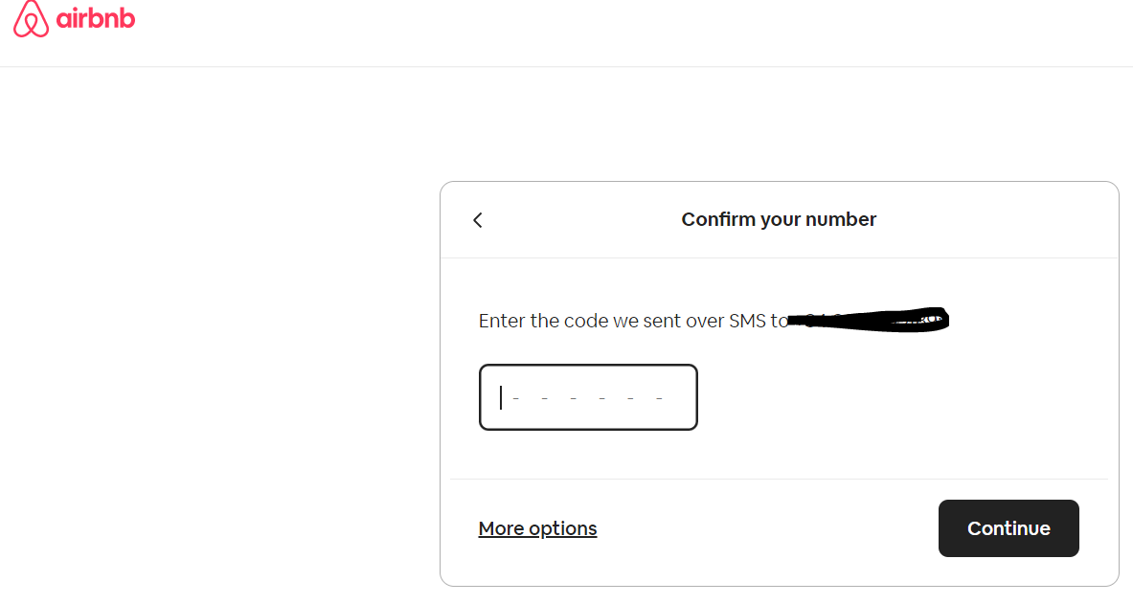
5. Exercise
2021-1-IT02-KA220-ADU-000035139
5.1 Create an Airbnb account
Click on “Confirm email”. Repeat this step and you are ready to go.
28

Slide 31
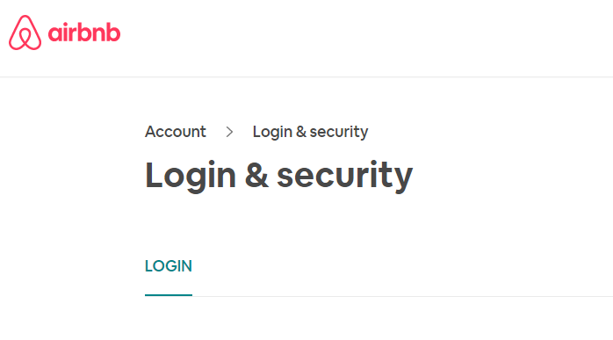
5. Exercise
2021-1-IT02-KA220-ADU-000035139
5.2 Deactivate account
Go to the top right corner and click on the button (three horizontal lines). Click on “Account” Then click on “Login & security”, scroll down and click on “Deactivate”.
29

Slide 32
Project No: 2021-1-DE02-KA220-VET-000030542
Thank you!
Follow us on Facebook!
Funded by the European Union. Views and opinions expressed are however those of the author(s) only and do not necessarily reflect those of the European Union or the European Education and Culture Executive Agency (EACEA). Neither the European Union nor EACEA can be held responsible for them.
Project No: 2021-1-IT02-KA220-ADU-000035139

Slide 33
E-leisure activities
Teaching resources (Activity 2)
Developed
by Dom Spain
Funded by the European Union. Views and opinions expressed are however those of the author(s) only and do not necessarily reflect those of the European Union or the European Education and Culture Executive Agency (EACEA). Neither the European Union nor EACEA can be held responsible for them.
Developed by xxxxxxxxx | Month, Year
Project No: 2021-1-IT02-KA220-ADU-000035139

Slide 34
1. Introductory activity
2021-1-IT02-KA220-ADU-000035139
1.1. Discussion
When travelling, how did you use to find and/or book an accommodation (either for work or for holidays)?
Is it easier to go on holiday now?
Is it safer to find accommodation now?
1

Slide 35
2. Comparative exercise
2021-1-IT02-KA220-ADU-000035139
 | Online | Analogue
Convenience | The Internet has no timetables and is independent of human customer service workers
Options available | Endless
Discounts and good deals | On the Internet there are platforms that allow you to compare prices
Cancellations | You have control over your booking (most of the time, or you can access as an extra service)
Bad experiences | You can avoid them. All the major booking platforms offer customer reviews.
2
Notes:
Convenience: Seniors usually prefer human interactions.
Options available: Sometimes having too many options may be a cause of “analysis paralysis”, meaning, people get anxious and decide not to continue with the activity.
Discounts and good deals: This could be discouraging (and reason for mistrust) for seniors as they can fall prey to “too good to be true” offers and scams.
Cancellations: Seniors may find difficult to find or understand the policies of cancellation. This could also be a reason for mistrust.
Bad experiences: Again, falling prey to scams can be a deterrent.

Slide 36
3. Brainstorming
2021-1-IT02-KA220-ADU-000035139
3.1.A Booking vs. Airbnb
Airnbnb.com. It manages accommodation rentals between private individuals and allows you to book a private room, apartment or a house for your holiday
The largest booking site in the world: Booking.com. It has the biggest choice of hotel accommodations around the world.
3

Slide 37
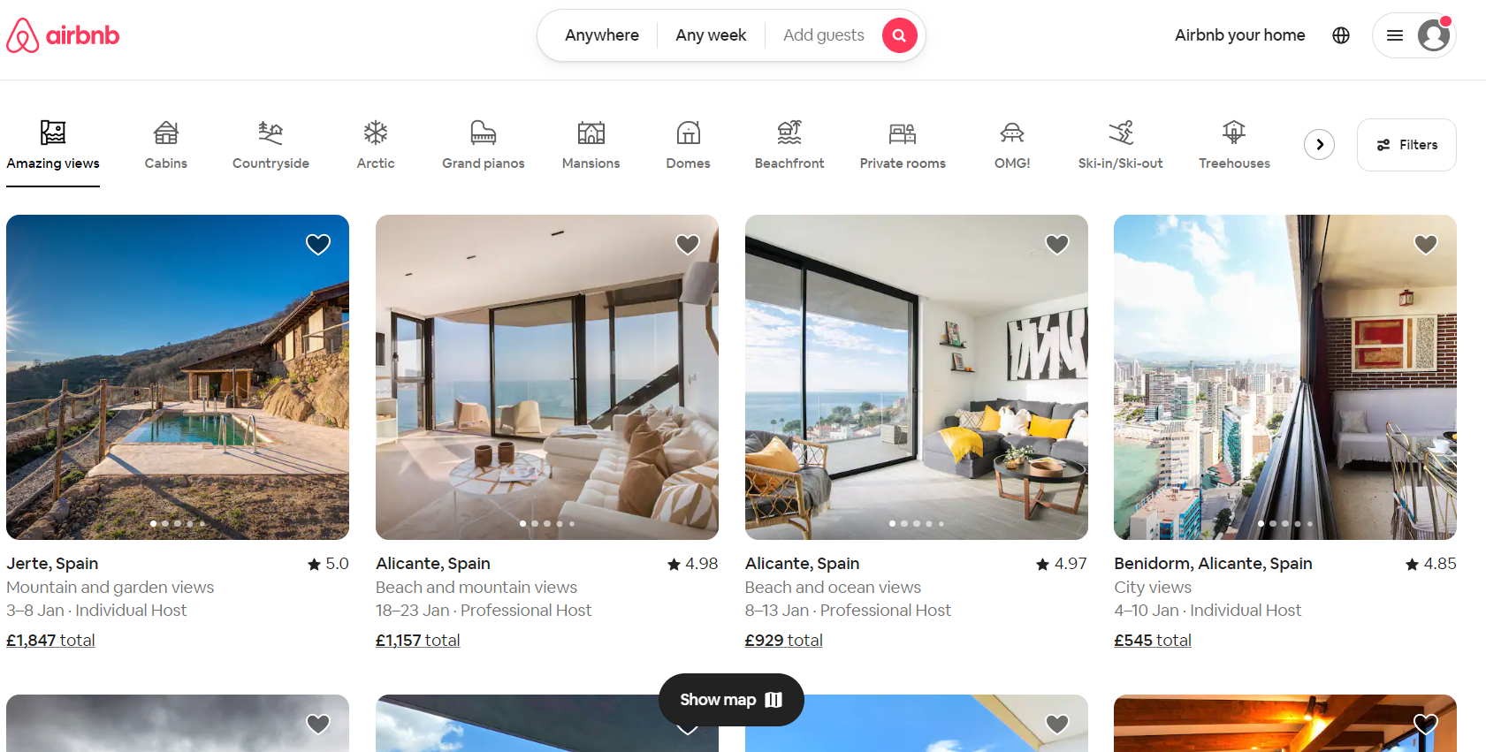
3. Brainstorming
2021-1-IT02-KA220-ADU-000035139
3.1. Booking vs. Airbnb
4

Slide 38
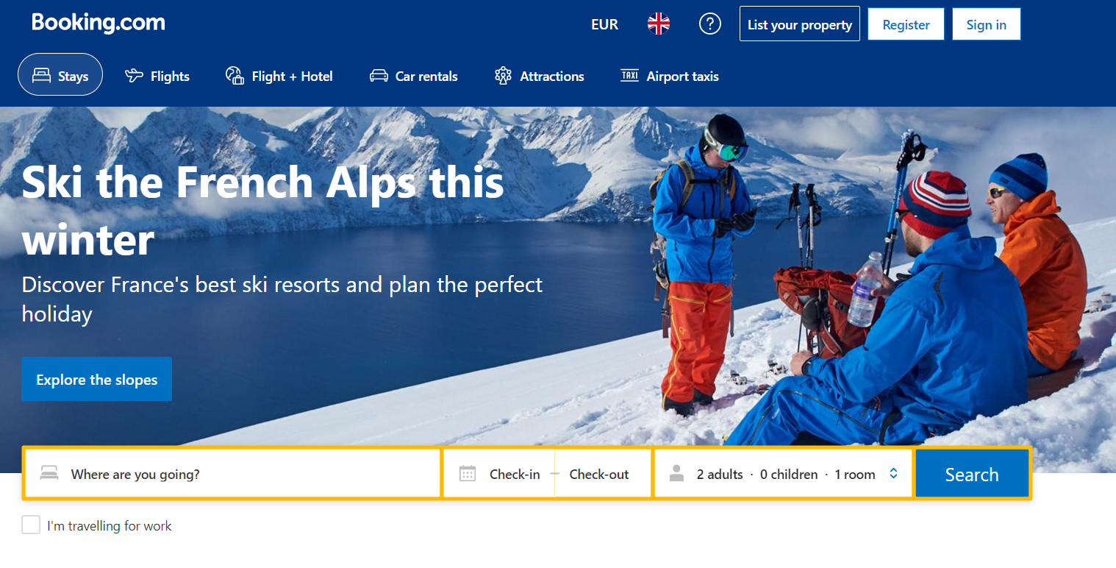
3. Brainstorming
2021-1-IT02-KA220-ADU-000035139
3.1. Booking vs. Airbnb
5

Slide 39
3. Brainstorming
2021-1-IT02-KA220-ADU-000035139
3.1.B Scenario
A family of 7 wants to go to the beach (2 parents + 3 children + 2 grandparents) What would be the best accommodation for them?
According to this, which website would be the best to find their accommodation? What important data do we need to have before we start our search? E.g. - Destination - ………………………. - ………………………. - Date of the trip - ………………………. - ……………………….
6

Slide 40
4. Demonstration
2021-1-IT02-KA220-ADU-000035139
4.1. Step by step
A) Go to your browser (Google Chrome or Microsoft Edge) B) Type "Airbnb" or "Booking" in the address bar C) Look for the web address (in green) in the list of options. Make sure it is the official website D) Check if the web address you clicked on corresponds to your country. In other words, check the country domain extension (.es , .it, .gr) E) Once inside the website, introduce the following information: destination, date (check-in and check-out) and number of travelers and click on "Search" F) Filter the information according to your needs (Airbnb: Show results; Booking: Search)
(Print this slide)
7

Slide 41
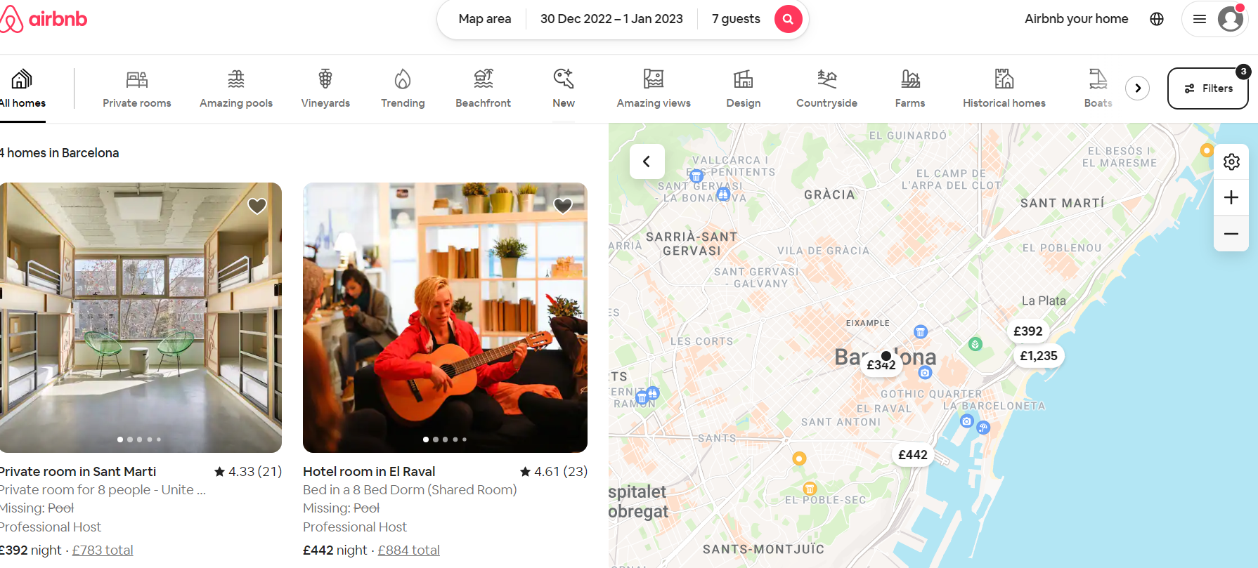
4. Demonstration
2021-1-IT02-KA220-ADU-000035139
Carefully review the following for each listing:
Description
Photos
Reviews
House rules
Amenities
Cancellation policy
Source: airbnb.com
4.1. Step by step
8

Slide 42
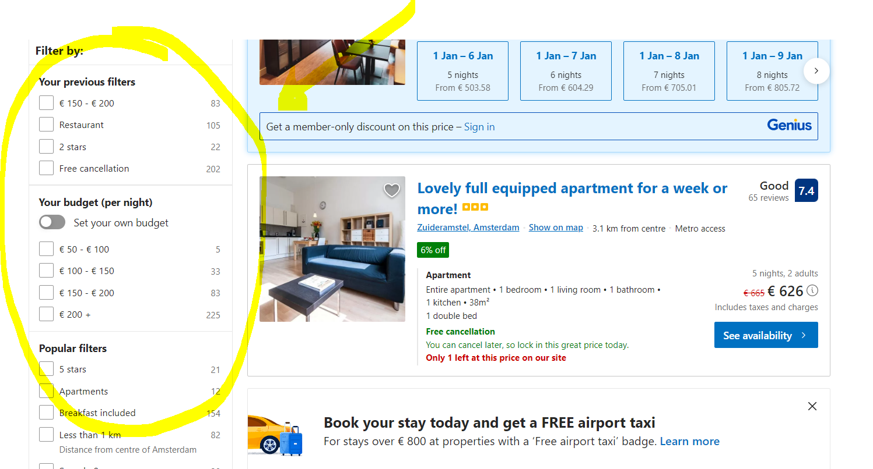
4. Demonstration
2021-1-IT02-KA220-ADU-000035139
4.1. Step by step
9

Slide 43
5. Exercise
2021-1-IT02-KA220-ADU-000035139
1) A couple is looking for a cheap but romantic hotel near the ”Sagrada Familia” in Barcelona. The maximum amount they can pay for accommodation is 200 EUR (Saturday and Sunday). They would like a parking space for their car and preferably a place with a pool.
2) A group of 5 friends are looking for group accommodation (large holiday home) near the beach on the "Costa Brava" in Catalonia, Spain. One of them uses a walking stick, so a single storey building or a place with a lift would be best. The maximum amount they can pay per night is 150 EUR (7 nights).
10

Slide 44
6. Evaluation and Reflection
2021-1-IT02-KA220-ADU-000035139
Were you frustrated when you used the tools? Was it difficult to use them?
Would you consider using these tools on your next holiday?
In your own words, what do you think of these kinds of websites in general?
11

Slide 45
Project No: 2021-1-DE02-KA220-VET-000030542
Thank you!
Follow us on Facebook!
Funded by the European Union. Views and opinions expressed are however those of the author(s) only and do not necessarily reflect those of the European Union or the European Education and Culture Executive Agency (EACEA). Neither the European Union nor EACEA can be held responsible for them.
Project No: 2021-1-IT02-KA220-ADU-000035139

Slide 46
E-leisure activities
Accessibility and add-ons
(Activity 3)
“Funded by the European Union. Views and opinions expressed are however those of the author(s) only and do not necessarily reflect those of the European Union or the European Education and Culture Executive Agency (EACEA). Neither the European Union nor EACEA can be held responsible for them.”
Developed by Domspain | January, 2023
Project No: 2021-1-IT02-KA220-ADU-000035139

Slide 47
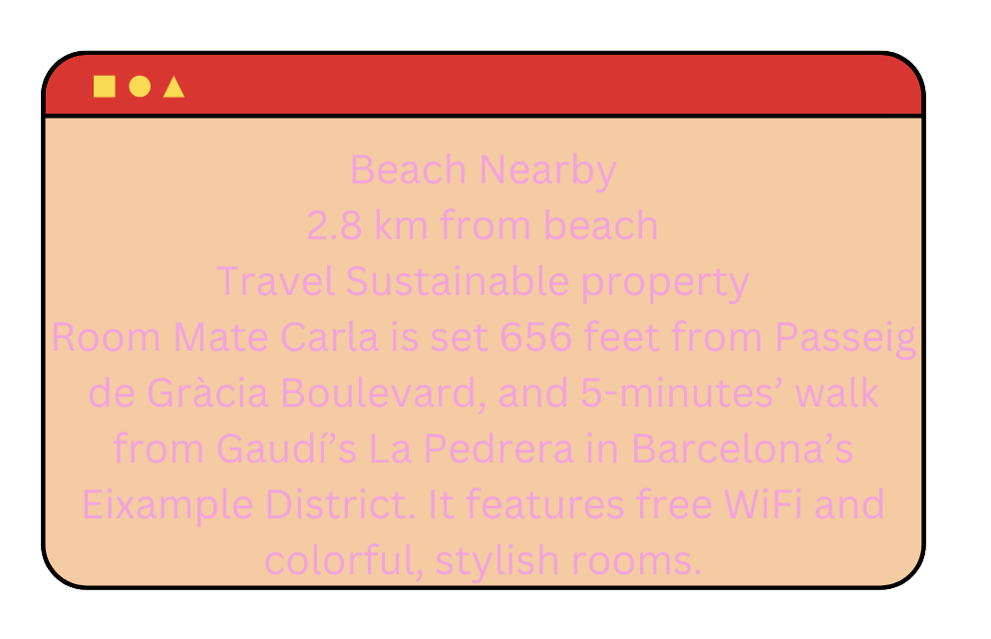
Introduction
2021-1-IT02-KA220-ADU-000035139
What is web accessibility?
Before answering this question, look at the following examples:
Screen view against bright sunlight
How about reading this text:
1

Slide 48
1. Introducing Web accessibility
2021-1-IT02-KA220-ADU-000035139
What is web accessibility?
Web accessibility means that websites, tools, and technologies are designed and developed so that people with disabilities can use them.
More specifically, people can:
perceive
understand
navigate
interact with the Web
contribute to the Web
2

Slide 49
1.1 Web accessibility key features
2021-1-IT02-KA220-ADU-000035139
Accessible websites main characteristics:
Essential for:
People with visual, hearing, motor impairments and learning and cognitive disabilities.
Good colour contrast
Understandable content
Keyboard functionality
Audio and video captions
Text alternatives for images
Useful for:
People with temporary and situational limitations (broken arm, bright sunlight, noisy environment, slow internet, older technologies etc.), older people, people with low literacy or non fluent in the language.
3

Slide 50
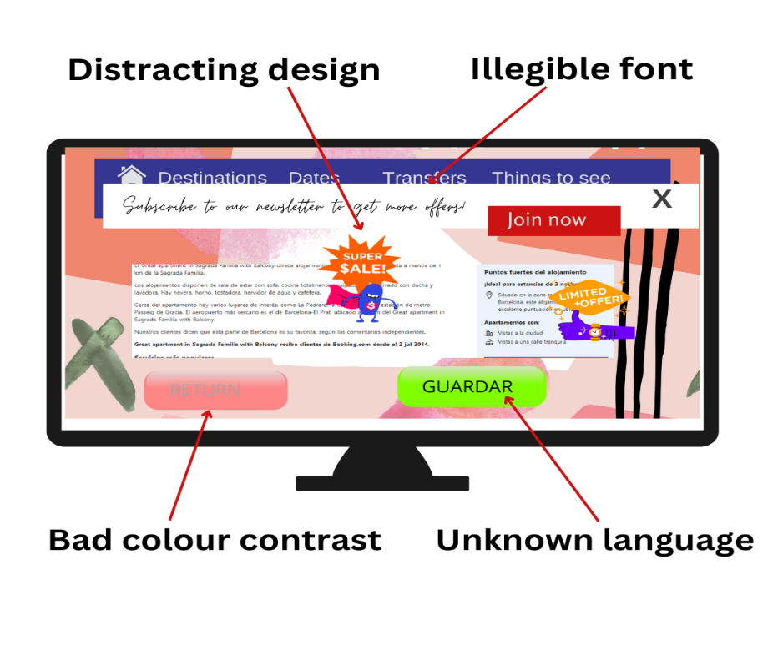
2. Accessibility compliance failures
2021-1-IT02-KA220-ADU-000035139
Although most big brands do their best to be accessible and to adapt their website features to users' needs, many websites sometimes fail to meet the most important accessibility requirements:
good colour contrast,
responsive website (adapts to screen size), readable fonts,
video subtitles and text alternatives for images,
keyboard functionality etc.
4

Slide 51
3. Improving accessibility on the user´s side
2021-1-IT02-KA220-ADU-000035139
Browser and platform settings:
Browser extensions:
These programmes add custom features to the main browser, such as:
Dark mode
Different fonts
Zoom
Spell checker
Translator
Remove advertisements etc.
Increase font size
Zoom
Use high contrast mode
5

Slide 52
4. Bowser settings
2021-1-IT02-KA220-ADU-000035139
You can adjust some of your browser settings to suit your needs by clicking on the 3 dots in the top right corner and selecting "Settings" in a pop-up window.
6

Slide 53
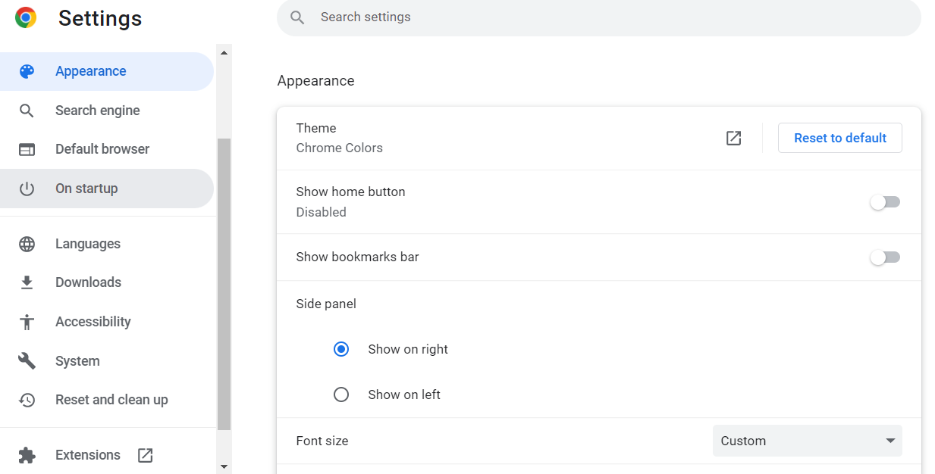
4.1 Browser settings
2021-1-IT02-KA220-ADU-000035139
Browser settings:
A new window with different setting options will be opened. Those that might be useful for improving the accessibility features are:
Appearance
Language
Accessibility
7

Slide 54
4.2 Browser settings – try it out!
2021-1-IT02-KA220-ADU-000035139
Exercise:
Open any page (e.g. www.hotels.com) Go to Browser settings Appearance Click on different options: Font size (try all of them); Customize fonts (try out the options you get on that page) and Page Zoom and observe the changes on the settings page as well as on the initial one.
Another easier way to zoom the page is clicking on the 3 dots in the browser and going directly to Zoom option in a drop down window.
8

Slide 55
5. Browser extensions
2021-1-IT02-KA220-ADU-000035139
The browser's setting options are quite limited and often not sufficient to improve web page navigation. Browser extensions can be very helpful here. The symbol for them can be found to the right from your browser command in a form of a tiny puzzle piece:
You may have used Google Translate to translate some words into another language. The Google Translate extension goes even further: once you have installed it, clicking on the extension's button automatically translates the entire web page into any language supported by Google Translate. An easy way to improve accessibility of a website in an unknown for you language!
9

Slide 56
5.1 Browser extensions – let's practice!
2021-1-IT02-KA220-ADU-000035139
Let us now go to an official website of a hotel in Germany: Pentahotel Leipzig
The website is available in 6 languages, but you are not fluent in any of them. It might be difficult to book a room and find out all the necessary information about the hotel and its services. But now we know what to do: use a Google Translate extension! Follow these steps and have the page translated into your language (if it is available in your language, try translating it into Polish):
Step 1: Search for Google translate in Chrome Web Store and install the extension.
Step 2: Check whether a little icon appeared in your browser toolbar (if not, then click on the extensions icon, search for this extension and pin it)
10

Slide 57
5.1 Browser extensions – let´s practice!
2021-1-IT02-KA220-ADU-000035139
Step 3: Go to the mentioned hotel website: Pentahotel Leipzig
Step 4: Click on the extension icon and click the language you want the page to be translated to (usually your native language).
11

Slide 58
5.1 Browser extensions – let´s practice!
2021-1-IT02-KA220-ADU-000035139
Step 5: Click on the 3 dots in order to choose some other language to translate to (e.g. Polish).
12

Slide 59
5.2 Browser extensions: A Powerful Web Assistant
2021-1-IT02-KA220-ADU-000035139
This is a great free tool to add to your browser that will customise navigation to your needs with the following features:
Font adjustment – allows to change the font as well as its boldness;
Animation toggle – allows to switch off all the annoying animation on the webpage;
Colour contrast – allows you to change the default background, text and link;
Text to speech – allows to read out loud the hovered text with more than 200 voice settings;
Tints and overlays – an overlay ruler that allows easily following the text on the screen and blocking out distracting content.
13

Slide 60
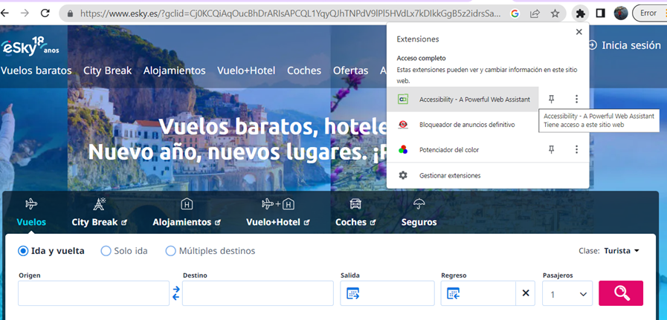
5.2 Browser extensions: A Powerful Web Assistant
2021-1-IT02-KA220-ADU-000035139
Let us try out some of the features of - A Powerful Web Assistant tool. As usual, we first need to install it from the Chrome Web Store. Once we have added it, we are set.
14

Slide 61
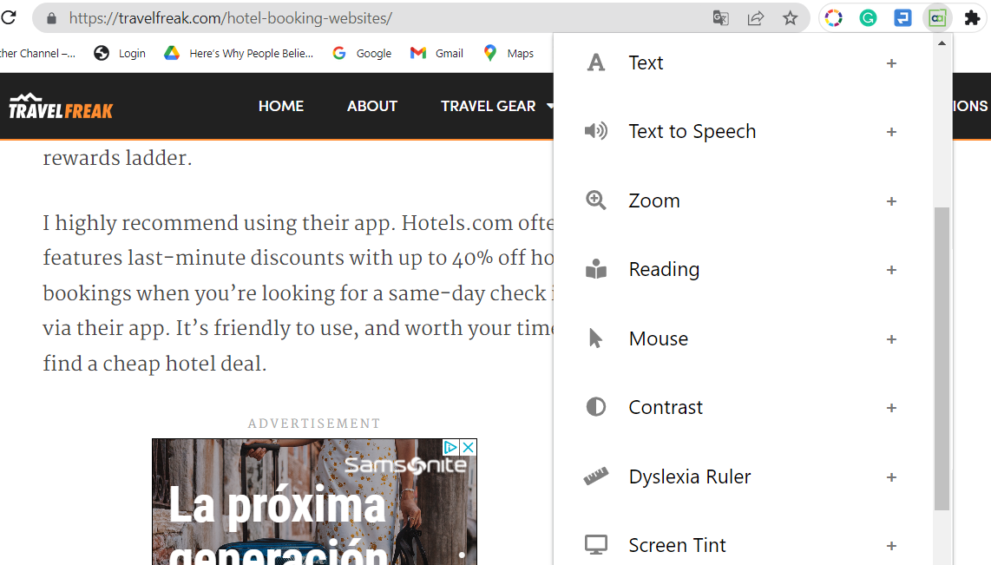
5.3 A Powerful Web Assistant: exercise
2021-1-IT02-KA220-ADU-000035139
Open any web page you want (it's better if it has images and colours);
Click on a tool icon in
in the top right corner of your browser
Try all the options in a drop down window:
Text
Zoom
Mouse
Contrast
Animations
Images
15

Slide 62
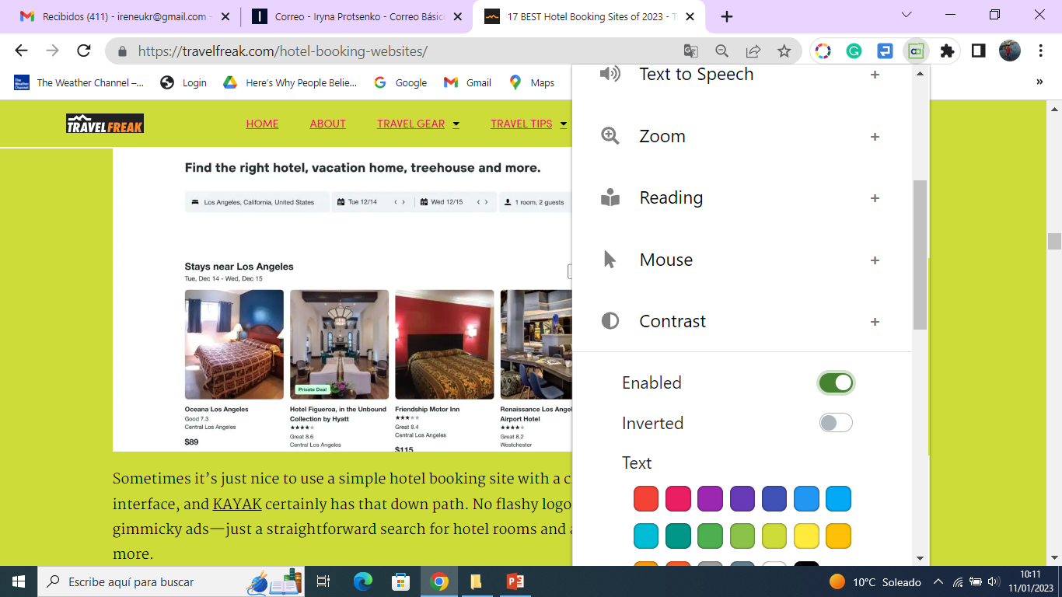
5.3 A Powerful Web Assistant: exercise
2021-1-IT02-KA220-ADU-000035139
Click on a “+”, enable the tool and observe the changes it produces on a page:
16

Slide 63
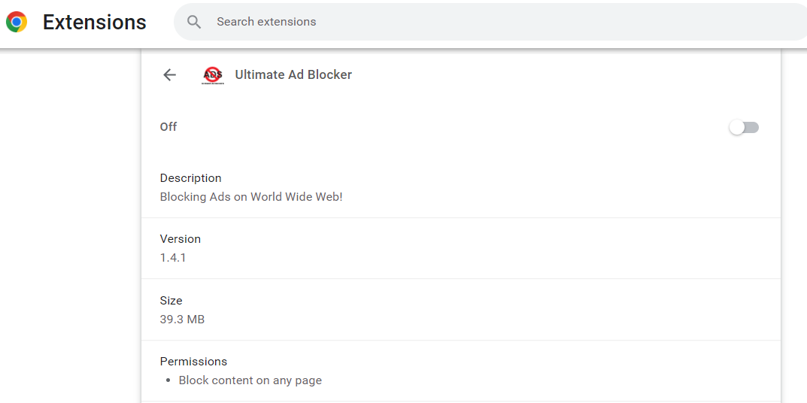
5.4 Browser extensions: Ultimate Ad Blocker
2021-1-IT02-KA220-ADU-000035139
Let's try out another useful tool – Ultimate Ad Blocker. It's a free tool that allows you to block ads, banners, pop ups, pre rolls and other ads on various websites. It is very easy to use. After you install the extension like the ones before, turn it on by clicking on the symbol in the top right corner of your browser, refresh the page and watch how the page is now free of ads.
17

Slide 64
Project No: 2021-1-DE02-KA220-VET-000030542
Thank you!
Follow us on Facebook!
Funded by the European Union. Views and opinions expressed are however those of the author(s) only and do not necessarily reflect those of the European Union or the European Education and Culture Executive Agency (EACEA). Neither the European Union nor EACEA can be held responsible for them.
Project No: 2021-1-IT02-KA220-ADU-000035139

