Slide 1

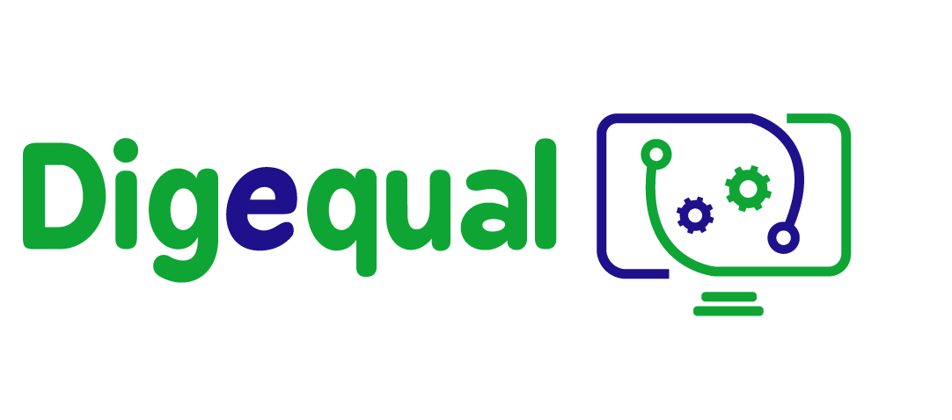


e-literacy
Lesson 1.
Introducing e-government
Funded by the European Union. Views and opinions expressed are however those of the author(s) only and do not necessarily reflect those of the European Union or the European Education and Culture Executive Agency (EACEA). Neither the European Union nor EACEA can be held responsible for them.
Developed by Polygonal | Dec, 2022
This project has been funded with the support of the European Commission. This publication reflects the views only of the author and the Commission cannot be held responsible for any use which may be made of the information contained therein.
Project No: 2021-1-IT02-KA220-ADU-000035139

Slide 2


Before starting! Who is afraid of e-government?
2021-1-IT02-KA220-ADU-000035139
DIFFICULTIES WITH THE ONLINE WORLD | WHEN DO YOU INTERACT WITH THE PUBLIC ADMINISTRATION OR OTHER PLATFORMS? | FEARS
1

Slide 3

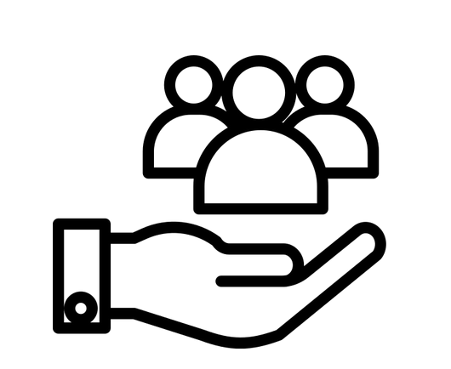
1.1 Introducing e-government
2021-1-IT02-KA220-ADU-000035139
What is e-government?
E-government stands for electric government or digital government.
E-government is the provision of public services to citizens using technology communications tools, such as computers and the Internet.
2

Slide 4
1.2 Introducing e-government
2021-1-IT02-KA220-ADU-000035139
How can we describe e-government?
Efficient, effective, transparent, functional, accessible, quality and interoperable are the terms that come to mind in describing e-government.
Why does e-government have so many positive aspects?
E-government tools are implemented with a user-centred approach so each citizen is the main beneficiary and user of the services
3

Slide 5
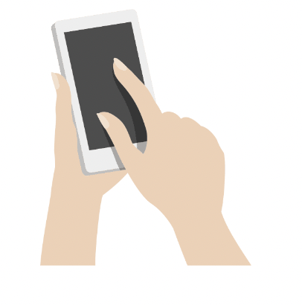
1.3 E-government in everyday life
2021-1-IT02-KA220-ADU-000035139
How can I use e-government services in my daily life?
You can pay your electricity bill online
You can book a visit to a museum
You can book a dentist appointment
You can sign an online petition
4

Slide 6
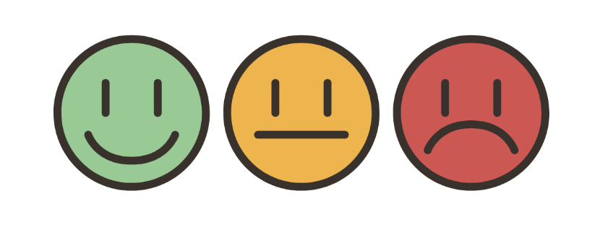
1.4 Self-assessment
2021-1-IT02-KA220-ADU-000035139
How much do you know about e-government?
How good are you at using a PC?
Do you feel autonomous in using e-government apps?
Fill in the self-assessment to find out
how confident you are with these tools
5

Slide 7

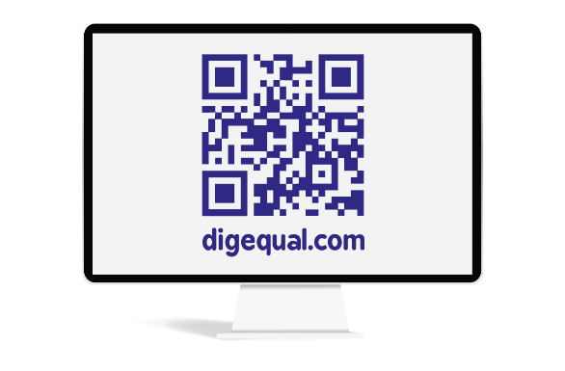
Project No: 2021-1-DE02-KA220-VET-000030542
Thank you!
Follow us on Facebook!
Project No: 2021-1-IT02-KA220-ADU-000035139

Slide 8
e-literacy
Lesson 2. Introducing cybersecurity
Funded by the European Union. Views and opinions expressed are however those of the author(s) only and do not necessarily reflect those of the European Union or the European Education and Culture Executive Agency (EACEA). Neither the European Union nor EACEA can be held responsible for them.
Developed by Polygonal | Dec, 2022
This project has been funded with the support of the European Commission. This publication reflects the views only of the author and the Commission cannot be held responsible for any use which may be made of the information contained therein.
Project No: 2021-1-IT02-KA220-ADU-000035139

Slide 9
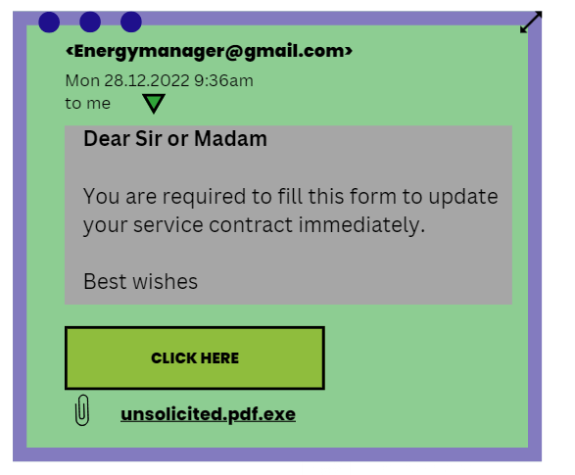
Before starting - Let's look at some of these messages together.
2021-1-IT02-KA220-ADU-000035139
1

Slide 10
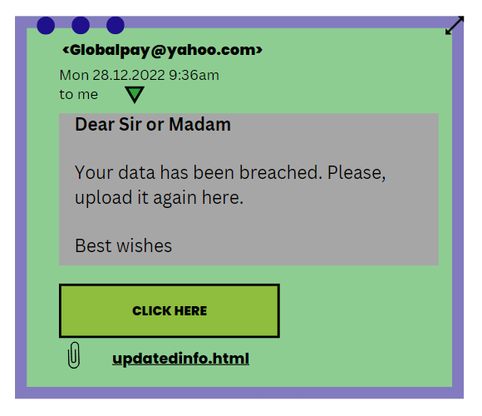
How about this?
2021-1-IT02-KA220-ADU-000035139
2

Slide 11

How about this?
2021-1-IT02-KA220-ADU-000035139
3

Slide 12
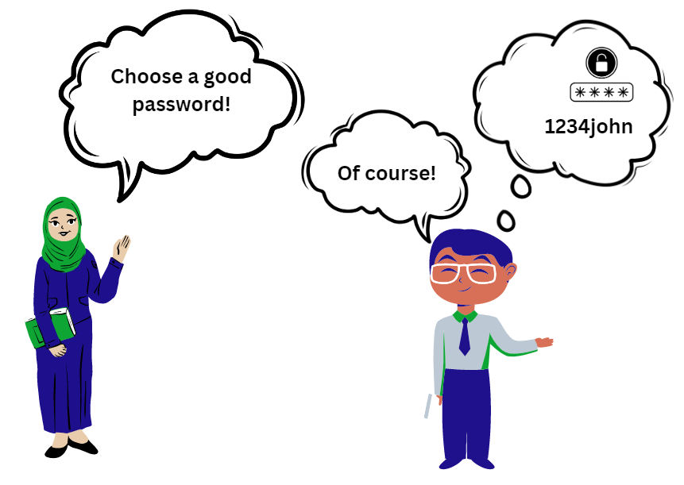
How about this?
2021-1-IT02-KA220-ADU-000035139
4

Slide 13
2.1 Introducing cybersecurity
2021-1-IT02-KA220-ADU-000035139
What is cybersecurity?
Cybersecurity is the ability to act safely and responsibly on digital service platforms and more broadly on the Internet.
In just a few steps, it is possible to protect personal data and minimise online risks.
5

Slide 14
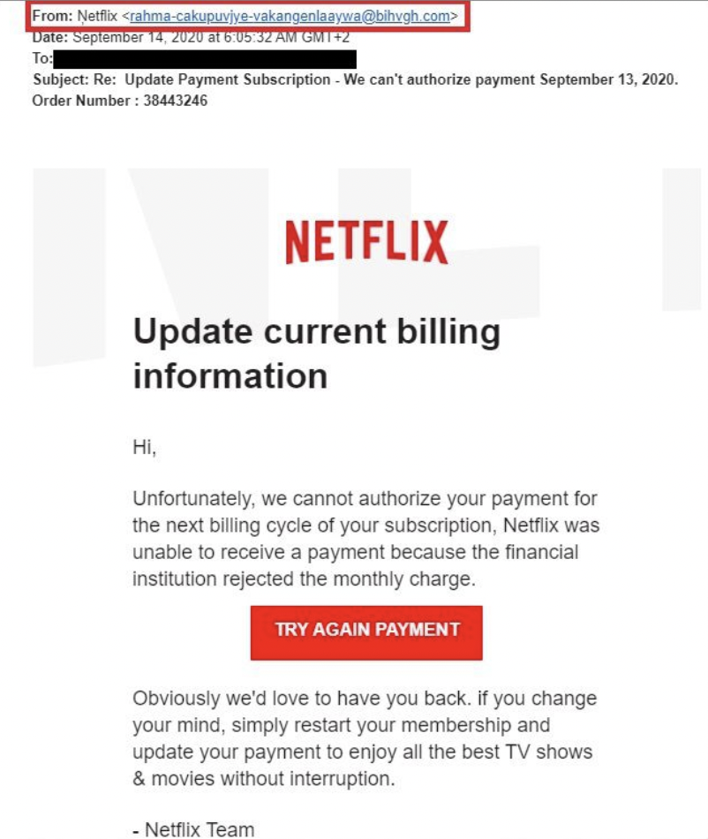
2.2 Possible cyber risks
2021-1-IT02-KA220-ADU-000035139
What are the possible risks?
Phishing: emails containing phishing scams will imitate the logos and e-mail domains of an official brand and make urgent requests to trick unsuspecting victims into thinking the message is genuine.
What are the red flags of this email ?
6

Slide 15
2.2 Possible cyber risks
2021-1-IT02-KA220-ADU-000035139
How to protect yourself from phishing attacks?
Be wary of unusual or misspelt email addresses
Don't open links or download suspicious attachments
Beware of generic greetings from an organisation that should know your name (e.g. a banking organisation calling you 'Mr. or Mrs.')
Be suspicious of messages promising rewards, refunds or prizes.
7

Slide 16
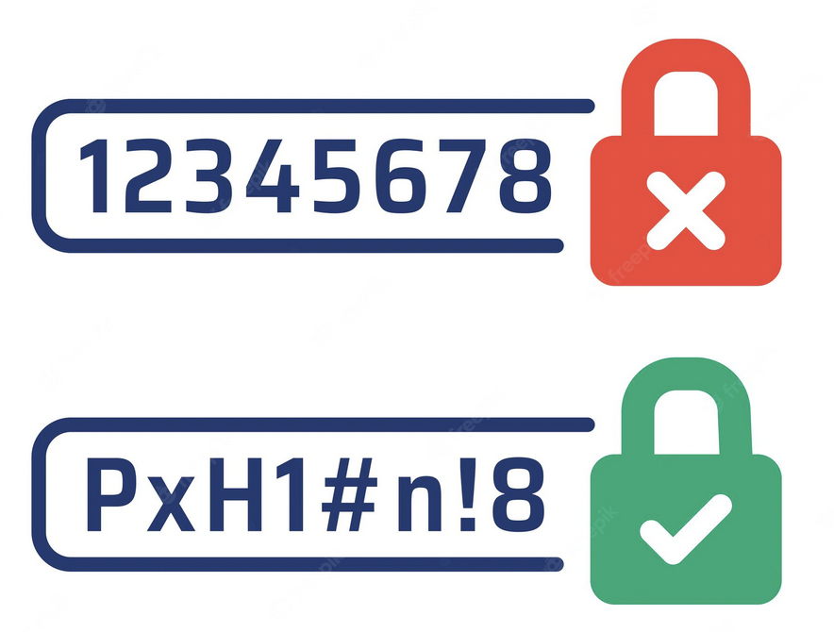
2.4 Possible cyber risks
2021-1-IT02-KA220-ADU-000035139
What are the possible risks?
Avoid weak passwords
How to create secure passwords?
Review and update your passwords regularly
use two-factor authentication whenever possible
don't use the same password for multiple accounts
use different passwords for different apps
use a password manager to store your passwords
8

Slide 17
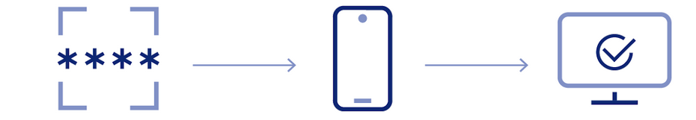
2.5 Two-factors authentication
2021-1-IT02-KA220-ADU-000035139
What is a two-factors authentication?
It is an additional layer of protection used to ensure that anyone attempting to access an online account are who they claim to be.
Step 1. First, a user will enter their username and password.
Step 2. Instead of gaining access immediately, they will have to provide some other information, e.g:
answers to “secret questions”
accept the request on a smartphone or a small hardware token
a PIN
a password
8

Slide 18
2.6 Possible cyber risks
2021-1-IT02-KA220-ADU-000035139
What are the possible risks?
Lack of computer security. Protecting your devices and your privacy is important and decrease your vulnerability to an attack.
How do you protect your devices?
be careful with public WLAN networks
lock your devices when not in use
update your operating system and software like anti virus apps regularly.
be aware of what you are consenting to (not all apps need your data)
be extremely careful when downloading files from the Internet
9

Slide 19

2.7 Digital identity
2021-1-IT02-KA220-ADU-000035139
It is an electronic way for an individual to create and manage their online identity. Digital identity is the internet equivalent of the true identity of a person or entity when used for identification in connections or transactions of computers, mobile phones, or other personal devices.
This online identity is a sum of any personal data existing online that can be traced back to the real you, and they can be photos, passwords, emails, payment data, addresses (online or offline).
Not only. Your digital identity encompasses also any action made online (navigation, purchasing, public posts, comment on social media, reposting etc.)
11

Slide 20
Project No: 2021-1-DE02-KA220-VET-000030542
Thank you!
Follow us on Facebook!
Project No: 2021-1-IT02-KA220-ADU-000035139

Slide 21
e-literacy
Lesson 3.
e-government usage in everyday scenarios
Funded by the European Union. Views and opinions expressed are however those of the author(s) only and do not necessarily reflect those of the European Union or the European Education and Culture Executive Agency (EACEA). Neither the European Union nor EACEA can be held responsible for them.
Developed by Polygonal | Dec, 2022
This project has been funded with the support of the European Commission. This publication reflects the views only of the author and the Commission cannot be held responsible for any use which may be made of the information contained therein.
Project No: 2021-1-IT02-KA220-ADU-000035139

Slide 22
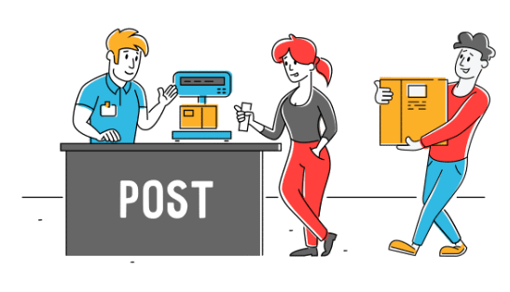
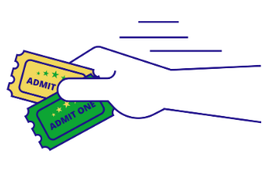

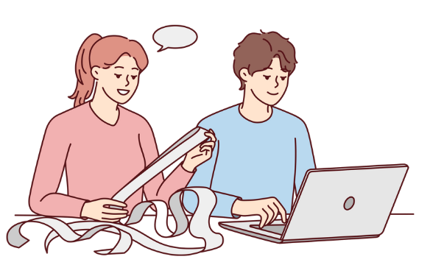
3.1 What do you think?
2021-1-IT02-KA220-ADU-000035139
When we deal with…
1

Slide 23
3.2 Let’s discuss: OFFLINE
2021-1-IT02-KA220-ADU-000035139
WHAT WE DO | PROS | CONS
2

Slide 24
3.3 Let’s discuss: ONLINE
2021-1-IT02-KA220-ADU-000035139
WHAT WE DO | PROS | CONS
3

Slide 25
Project No: 2021-1-DE02-KA220-VET-000030542
Thank you!
Follow us on Facebook!
Project No: 2021-1-IT02-KA220-ADU-000035139

Slide 26
e-literacy
Lesson 4. Digital identity
Funded by the European Union. Views and opinions expressed are however those of the author(s) only and do not necessarily reflect those of the European Union or the European Education and Culture Executive Agency (EACEA). Neither the European Union nor EACEA can be held responsible for them.
Developed by Polygonal | Dec, 2022
This project has been funded with the support of the European Commission. This publication reflects the views only of the author and the Commission cannot be held responsible for any use which may be made of the information contained therein.
Project No: 2021-1-IT02-KA220-ADU-000035139

Slide 27
3.1 Digital Identity
2021-1-IT02-KA220-ADU-000035139
How can I access e-government services?
To access e-government services, you need to create a Digital Identity, through which you securely and reliably prove your identity.
Typically, a digital identity for digital government services is created from your identity document (usually from the ID card).
Digital identity is an important enabler for improving public services such as healthcare, social benefits, certificates and licences.
1

Slide 28
3.2 Create a Digital Identity
2021-1-IT02-KA220-ADU-000035139
What do I need to create my Digital Identity?
be 18 years of age or older
have a smartphone or other smart device
have a personal email address or mobile phone number
download the app from the national government
Prepare identification documents, e.g. your passport or ID card, to confirm your identity
2

Slide 29

3.3 Create a Digital Identity
2021-1-IT02-KA220-ADU-000035139
What can you do to make access to your digital identity more secure?
change your PIN or password
view or update your identity documents
activate Face ID if your smart device is equipped with it
3

Slide 30
3.4 The main digital identity systems in our country
2021-1-IT02-KA220-ADU-000035139
5

Slide 31
Project No: 2021-1-DE02-KA220-VET-000030542
Thank you!
Follow us on Facebook!
Project No: 2021-1-IT02-KA220-ADU-000035139

Slide 32
e-literacy
The essentials for using e-government services with your own mobile
Funded by the European Union. Views and opinions expressed are however those of the author(s) only and do not necessarily reflect those of the European Union or the European Education and Culture Executive Agency (EACEA). Neither the European Union nor EACEA can be held responsible for them.
Developed by Polygonal | Dec, 2022
This project has been funded with the support of the European Commission. This publication reflects the views only of the author and the Commission cannot be held responsible for any use which may be made of the information contained therein.
Project No: 2021-1-IT02-KA220-ADU-000035139

Slide 33
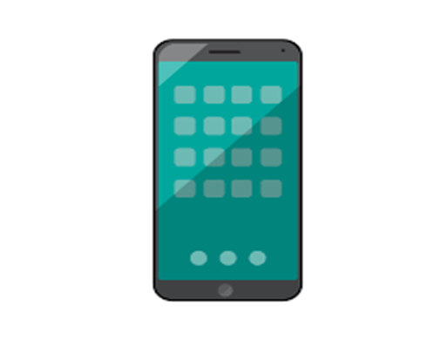
5.1 Email
2021-1-IT02-KA220-ADU-000035139
Our email is a real key, as it is the token to access everywhere, especially on our phones.
Through an email we are able to create a smartphone space as a repository of data that are portable. In this way, the phone is only an interface of data stored somewhere.
WITHOUT an email it is not possible to access to smartphones, or is it possible to access on many websites.
1

Slide 34

5.2 How to create an email
2021-1-IT02-KA220-ADU-000035139
Step 1. Select a website that provides email services: e.g. google.com
Step 2. Find out where you can sign up and click on create an account
Step 3. Follow all the instructions on the form and fill in all mandatory information (mandatory information usually has an asterisk symbol*)
in the creation of your email address we suggest to use a combination of your name and surname: e.g mariorossi@gmail.com
2

Slide 35
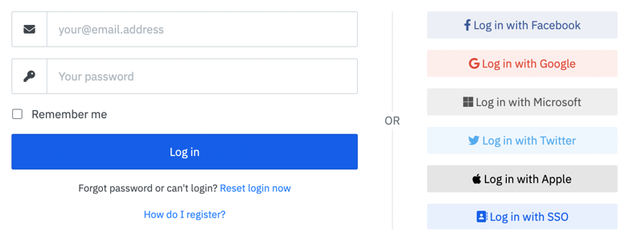
5.3 How to use an email account or other accounts
2021-1-IT02-KA220-ADU-000035139
in many apps we can access by connecting them directly to our accounts - which is very convenient.
3

Slide 36
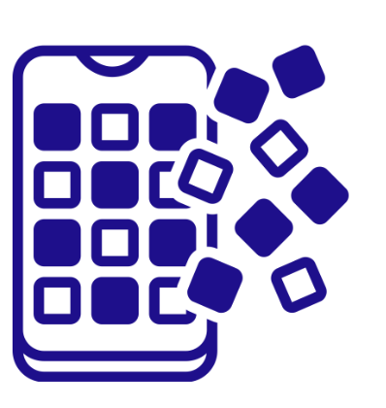
5.4 What are applications or apps?
2021-1-IT02-KA220-ADU-000035139
Apps are packets of information with which we interface to do a series of actions.
Apps are developed and tested software found on a series of spaces called 'app stores'.
For Android users, the app store is called 'play store', for iOS/apple users, 'Apple store'.
It is important to check the reviews before downloading an app. Try to avoid apps that have lots of bad reviews.
4

Slide 37


5.5 What are applications or apps?
2021-1-IT02-KA220-ADU-000035139
Google's Android and Apple's iOS are operating systems used primarily in mobile technology, such as smartphones and tablets.
5

Slide 38

5.6 add a PIN to access your devices
2021-1-IT02-KA220-ADU-000035139
it's always good to have a pin to restrict access to your phone.
Do not use 1234!
on the latest generation smartphones it is possible to add your fingerprint or face recognition
6

Slide 39

5.7 Hotspot
2021-1-IT02-KA220-ADU-000035139
no internet!
what can we do?
7
Notes:
- the tutor invites participants to check the function on the settings area
- the tutor can show how to set a name and a password
- the tutor can make other participants browse for the new hotspot

Slide 40

5.8 NFC
2021-1-IT02-KA220-ADU-000035139
NFC allows to exchange data between two devices at close distance. Is the technology that underpins contactless payments.
It is so widespread that it is no longer necessary to have credit/debit cards with you, but only the phone
8

Slide 41
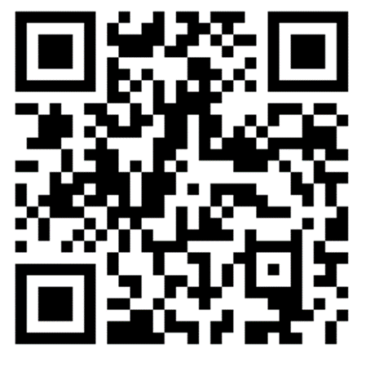
5.9 A QR code?
2021-1-IT02-KA220-ADU-000035139
QR code looks similar to barcodes but have a square shape
Most of the latest generation phones have QR recognition via their own camera app.
Otherwise, you can download an app to scan any QR.
Could you scan this QR?
9

Slide 42
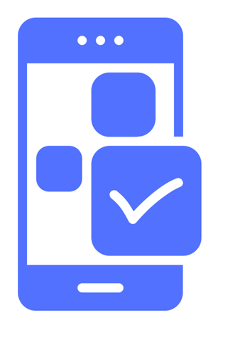
5.10 Other useful functions on our smartphone
2021-1-IT02-KA220-ADU-000035139
what other features do you know?
bluetooth
flight mode
wallet
geolocation
battery optimization
10

Slide 43

5.11 Cloud backup
2021-1-IT02-KA220-ADU-000035139
What happens if you lose your phone? What if the phone falls and breaks?
Data may be lost! :(
So, it is fundamental to have a 'place' where to have all your data.
Like a kind of small island that only you can access
google drive (basic version). google one payment version.
icloud (space depending on your purchase plan)
11

Slide 44
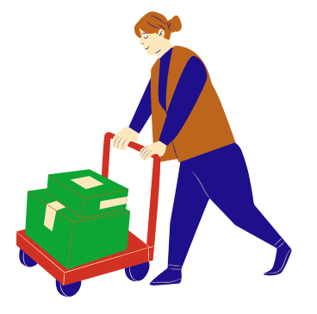
5.12 Why using cloud services?
2021-1-IT02-KA220-ADU-000035139
A cloud service allows you to save your data beside any incident!
This way, all our data is like a kind of package that we can move from one device to another without losing anything, and in complete security.
12

Slide 45
Project No: 2021-1-DE02-KA220-VET-000030542
Thank you!
Follow us on Facebook!
Project No: 2021-1-IT02-KA220-ADU-000035139
This project has been funded with the support of the European Commission. This publication reflects the views only of the author and the Commission cannot be held responsible for any use which may be made of the information contained therein.

